Slide 1
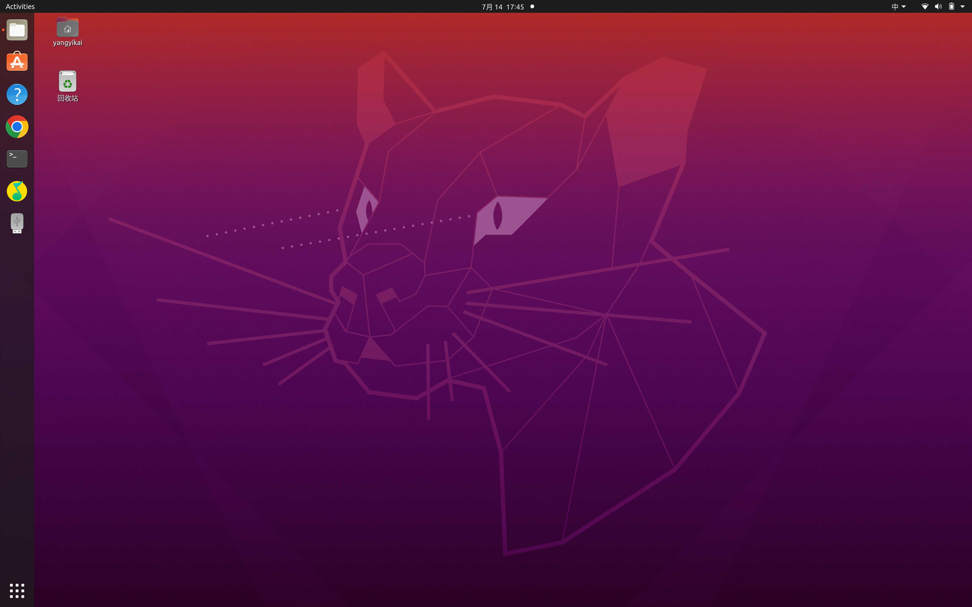

Go Linux !!!
Maker:Yang Yikai（杨译凯）
Wang Zheng（王正）
Guo Chengyuan（郭承远）
Li Xirui(李熙锐)
Presented by boys next door

Slide 2

Presented by boys
Content
Content
Introduction
Image
Prototype
System

Slide 3
1.Introduction

Slide 4



Introduction — Background
Three camp
linux
mac
windows
76.31%
every camp want to make computer all over the world to use their own sysytem.
2.43%
14.66%

Slide 5
Introduction — Hero
Name:
Linux
Goal :
To make every computer system in the earth to be linux

Slide 6








Introduction — Control
"Space"
Hit
"AD"
Walk
"W"
Jump
"E"
Use "icon"
aim to win this scene
gift
trap
transport

Slide 7
2.Image

Slide 8
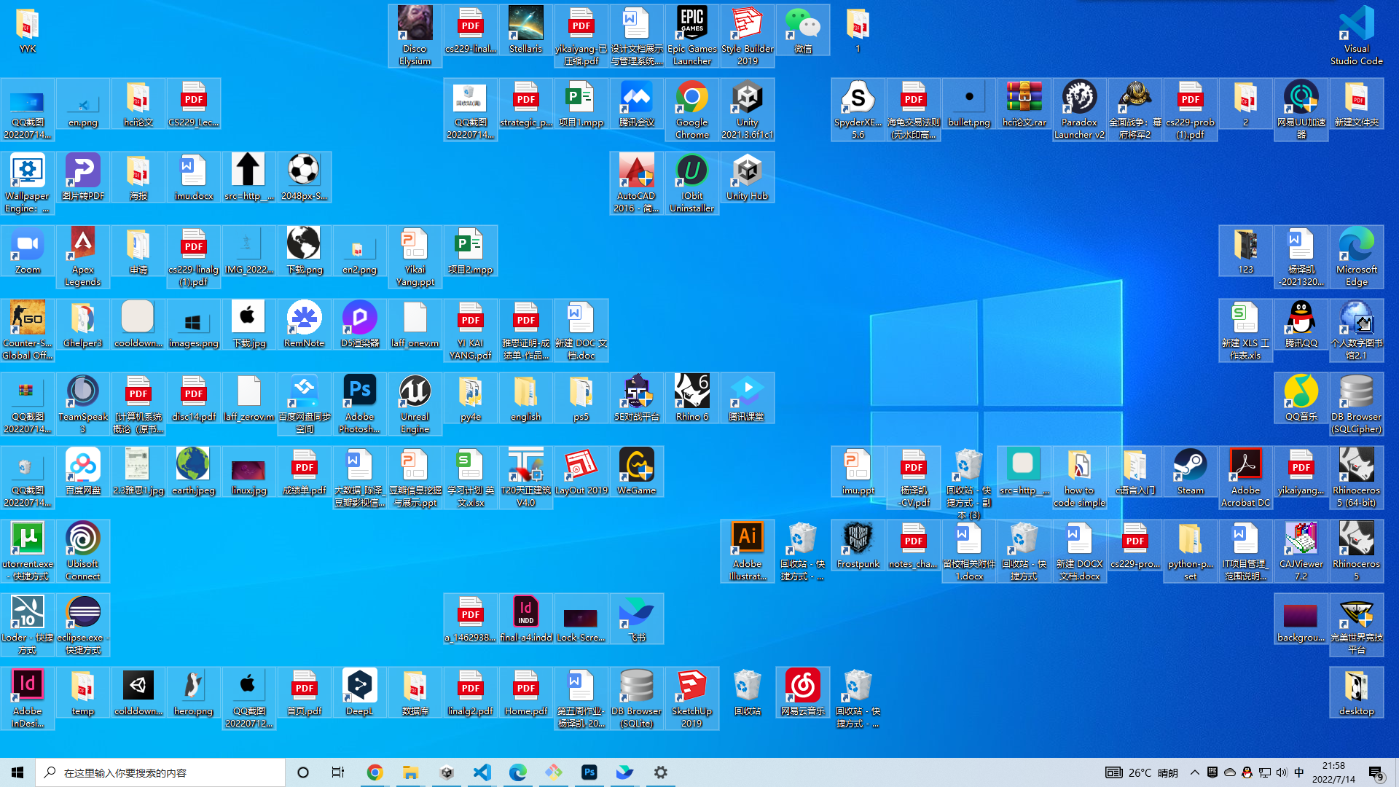

Image — Scenc example

Slide 9
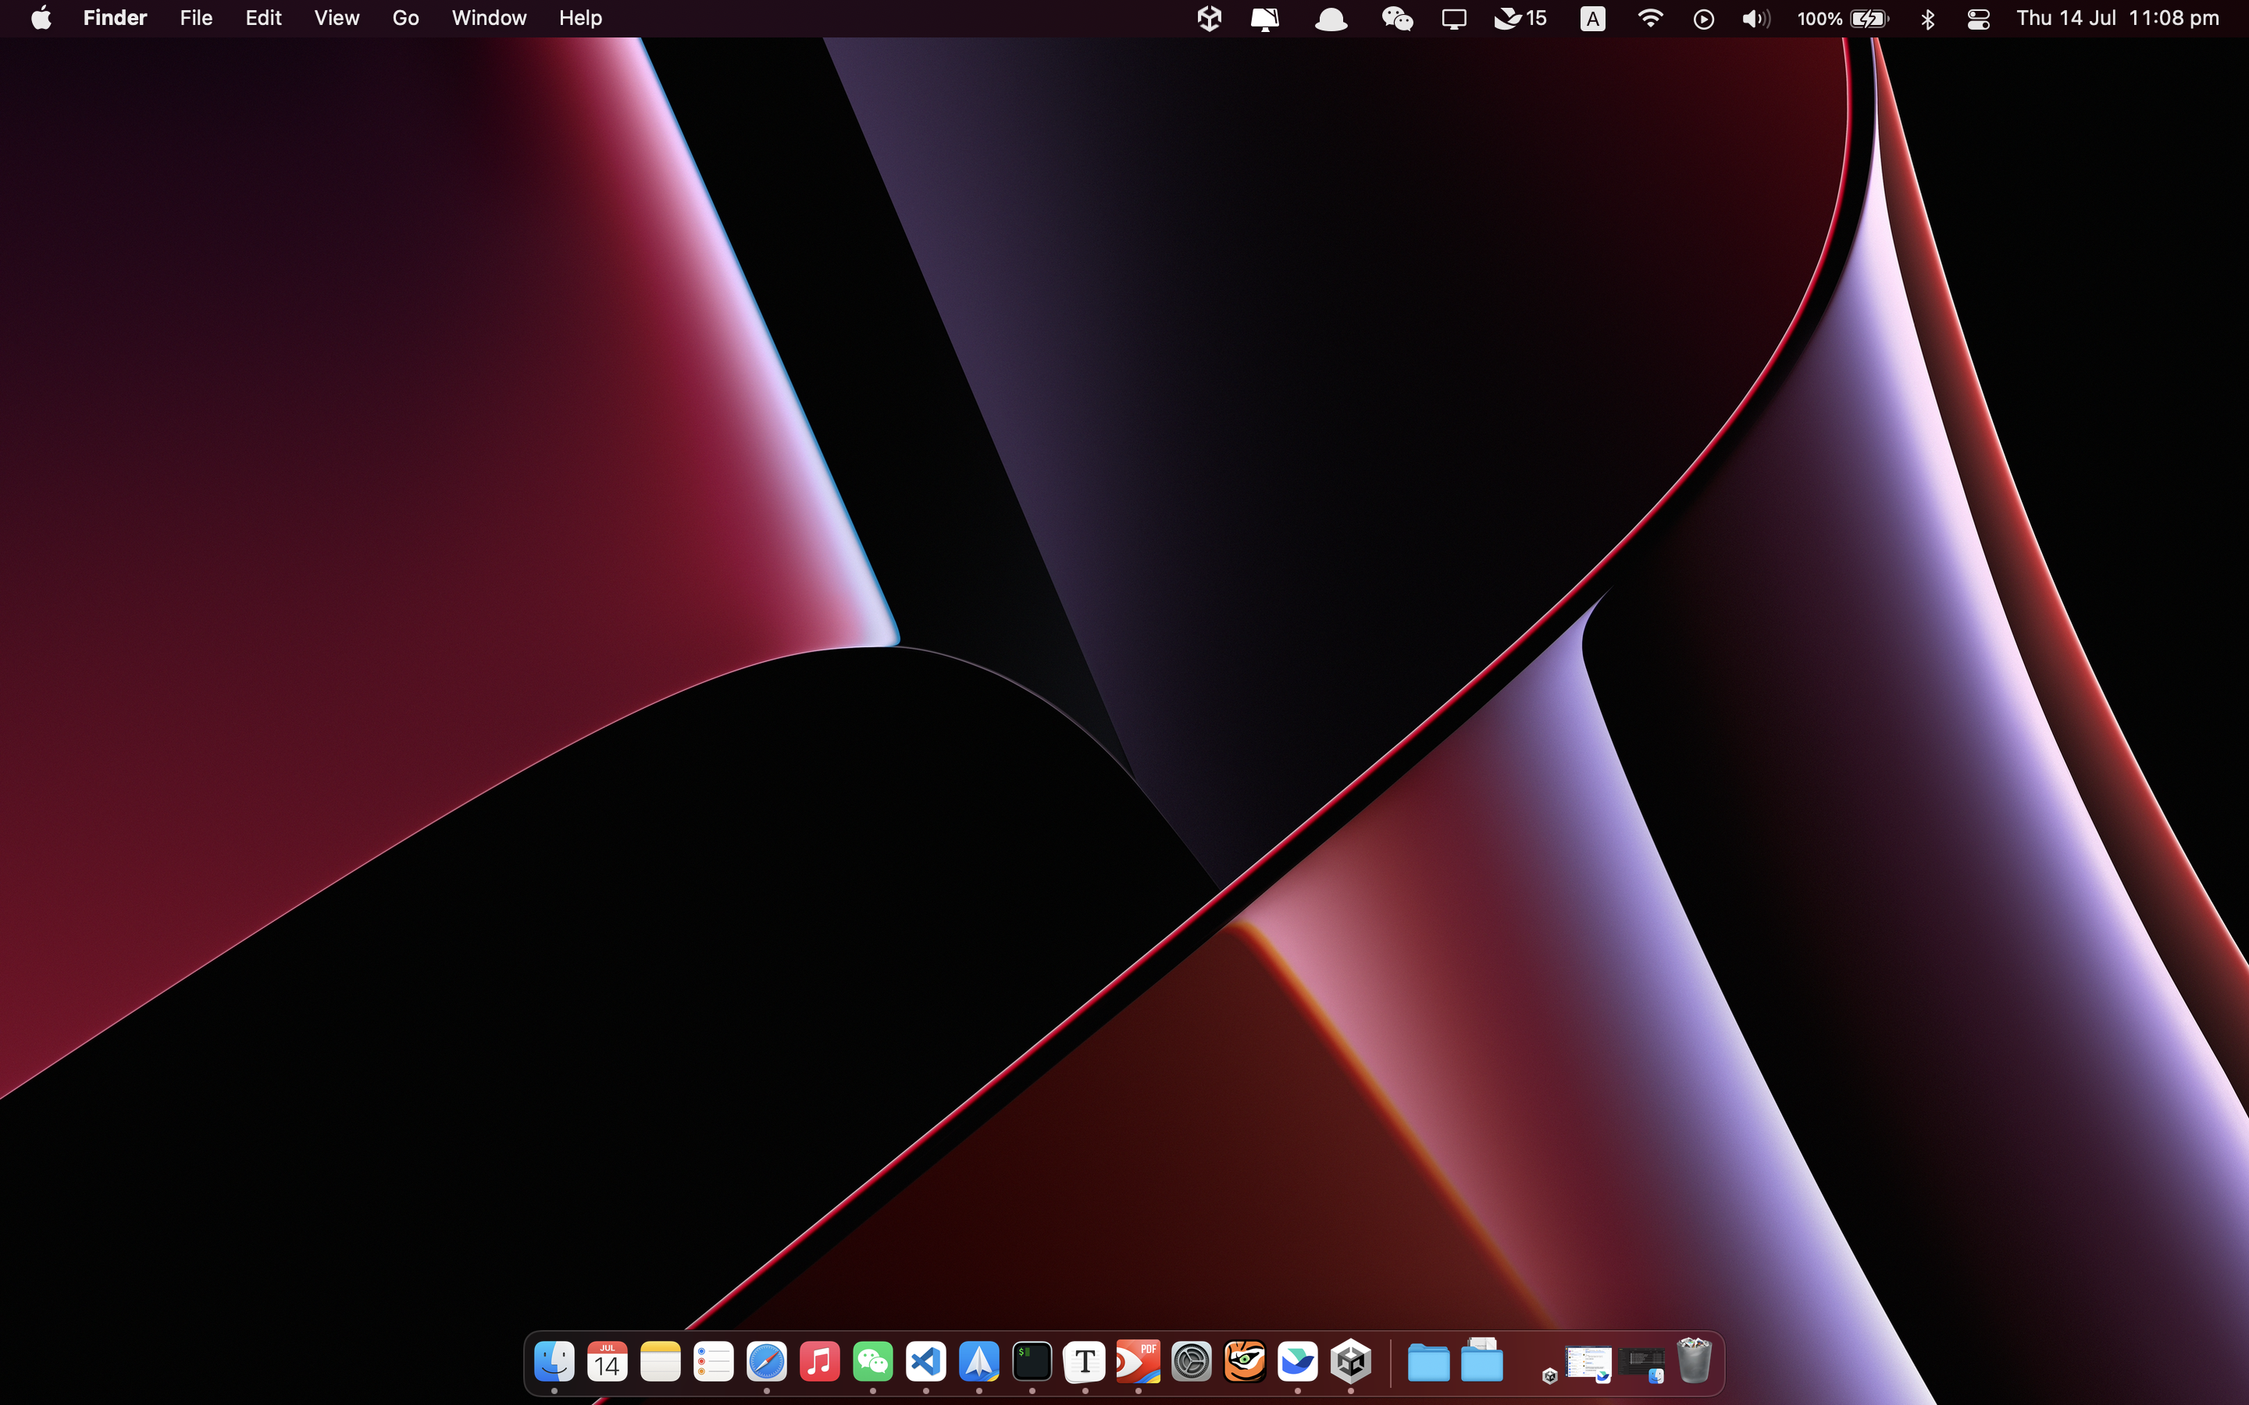
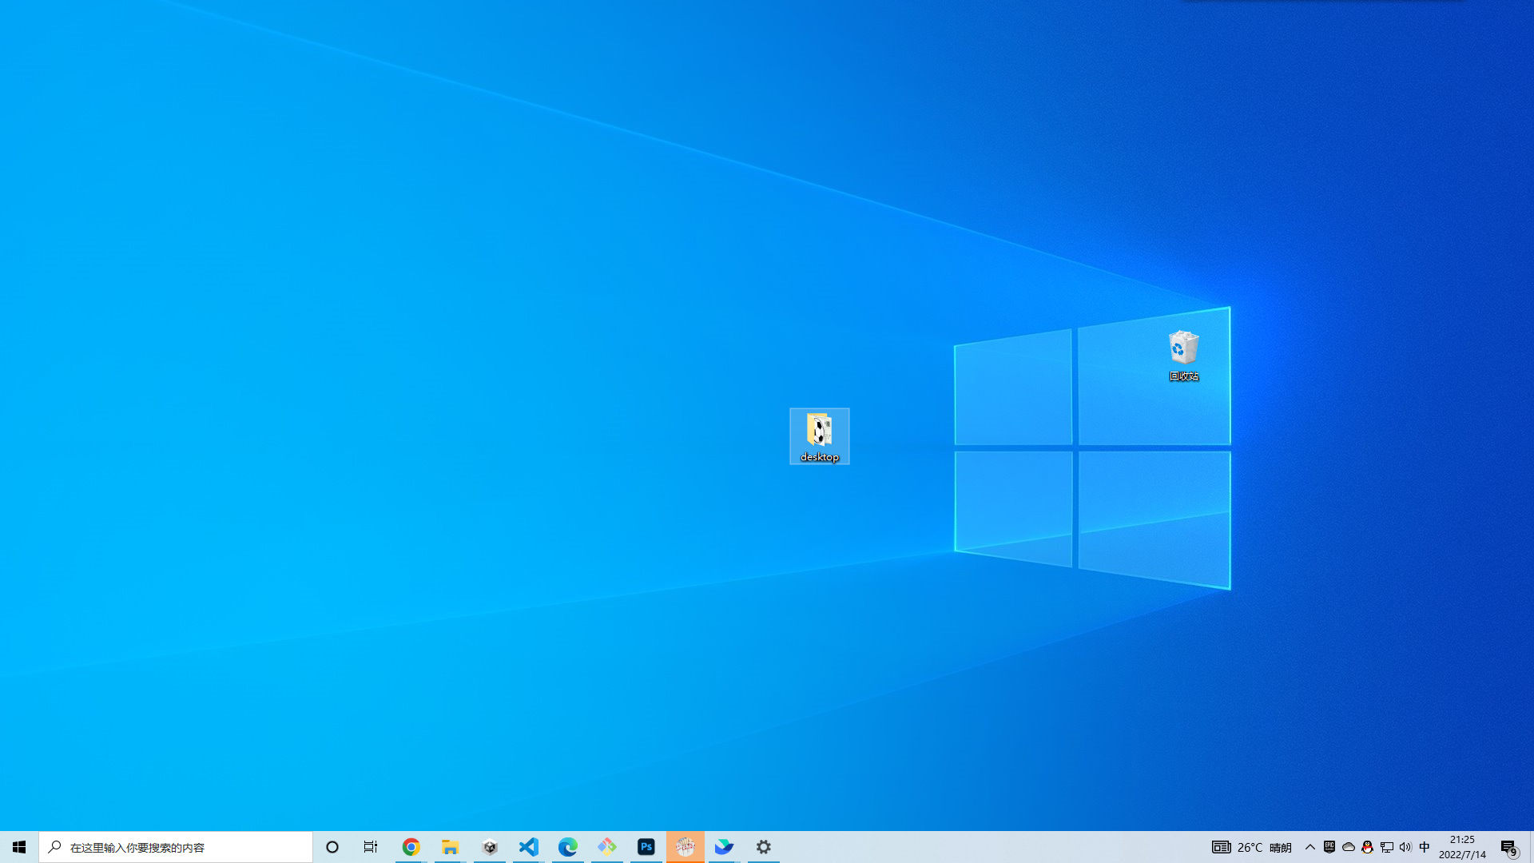
Introduction — Process
2.43%
main scece
mac fight scece
windows fight scece

Slide 10
3.Prototype

Slide 11
the basic action of the hero,which cantain move byA、D and space to hit,W to jump
design part of the scene and hero can interact with it.
change scene:main-game-baltte
simple battle scence,which is likes the Metroidvania(银河恶魔城). hero can hit enemy with weapen and enemy can use its own way to hit the hero.
enemy can enter shoot and can be shot and die
Hero's HP system、Enemy with working HP meter (for bosses)
Prototype — must

Slide 12
the behavior of our hero is mutiple including but not limited to attack and interacting with icons.
the enemy need to find hero and attack it.So,we may use the algorithms like A* and we have to make the enemy "stupid" to make our game more frendly to players.
we will design a Finite State Machine to the hero and enemy to support its automation.
the design of interesting things in the scence.
Prototype — Challenges

Slide 13
4.System

Slide 14
GlobalVariableSystem which manage all gloabal variables
SceneManageSystem which navigate different scenes.
In each scenes that different icons should be different prefabs and include change scene.
Battle(Enemy)System which supports the battle, returning the battle results
Mostly are UIs
few animation depends on the battle-type we finally decide
HeroSystem(wish:ShopSystem) which allows you to control hero and power up your chara and defeat more difficult enemies.
unique weapons(wish) for your chara
Systems

Slide 15
Thank you!

